Slide 1
Semantics, Names and Environment Week 2

Slide 2
Semantics
Operational semantics
Sample semantics

Slide 3
Semantics
A formal grammar define the syntax of a language
A (formal) semantics defines how the instructions are executed given an input to generate an output
A semantics therefore gives meaning to a program

Slide 4
Defining Language Semantics
What properties do we want from language semantics definitions?
Preciseness
Predictability
Complete
How to specify language semantics?
English specification
Reference implementation
Formal language

Slide 5
English Specification
C99 language specification is 538 pages long
"An identifier can denote an object; a function; a tag or a member of a structure, union, or enumeration; a typedef name; a label name; a macro name; or a macro parameter. The same identifier can denote different entities at different points in the program. A member of an enumeration is called an enumeration constant. Macro names and macro parameters are not considered further here, because prior to the semantic phase of program translation any occurrences of macro names in the source file are replaced by the preprocessing token sequences that constitute their macro definitions."
In general, can be ambiguous, not correct, or ignored
What about cases that the specification does not mention?
However, good for multiple implementations of the same language

Slide 6
Reference Implementation
Until the official Ruby specification in 2011, the Ruby MRI (Matz's Ruby Interpreter) was the reference implementation
Any program that the reference implementation run is a Ruby program, and it should do whatever the reference implementation does
Precisely specified on a given input
If there is any question, simply run a test program on a sample implementation
However, what about bugs in the reference?
Most often, they become part of the language
What if the reference implementation does not run on your platform?

Slide 7
Formal Specification
Specify the semantics of the language constructs formally (different approaches)
In this way, all parts of the language have an exact definition
Allows for proving properties about the language and programs written in the language
However, can be difficult to understand

Slide 8
From text to meaning
Different stages
Lexical analysis
Syntactical analysis
Semantic analysis
Various stages of memory allocation and code generation

Slide 9
Lexical Analysis
A preparatory step for syntactical analysis
The aim of lexical analysis is to read the symbols (characters) forming the program sequentially from the input and to group these symbols into
If goes left to right and it can be implemented with a regular grammar
Check if proper sequence of symbols of the language have been used

Slide 10
Syntactical Analysis
Already well discussed
It implies the application of a formal grammar (context-free)
The output is the derivation tree or a syntax error

Slide 11
Semantic Analysis
The derivation tree produced by the grammar is processed and “executed”
Crucial things to do:
Resolve names and allocate the proper space in memory
Attach a scope to each allocated object
Be able to interpret the instructions and modify the content of the memory accordingly in order to reach the program output
In several paradigms (not all of them), the content of the memory is the “state” of the program, and a semantics specify how each instruction modify the state

Slide 12
Approaches
Need for exactness as well as for flexibility
No ambiguity
Two approaches
Denotational
Operational

Slide 13
Specifying a Semantics
Denotational: Denotational semantics is the application to programming languages of techniques developed for the semantics of logico-mathematical languages. The meaning of a program is given by a function which expresses the input/output behaviour of the program itself.
Operational: n the operational approach, on the other hand, there are no external entities (for example, functions) associated with language constructs. Using appropriate methods, an operational semantics specifies the behaviour of the abstract machine. That is, it formally defines the interpreter, making reference to an abstract formalism at a much lower level.

Slide 14
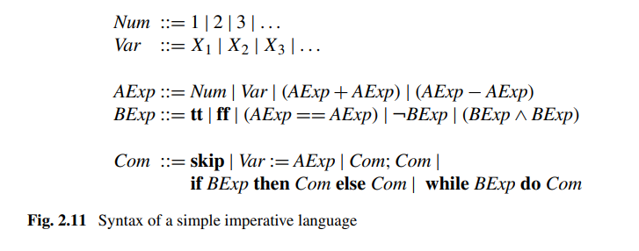
Operational Approach
Specify the effect of each instructions on the state of the program
Let’s consider the following language:

Slide 15
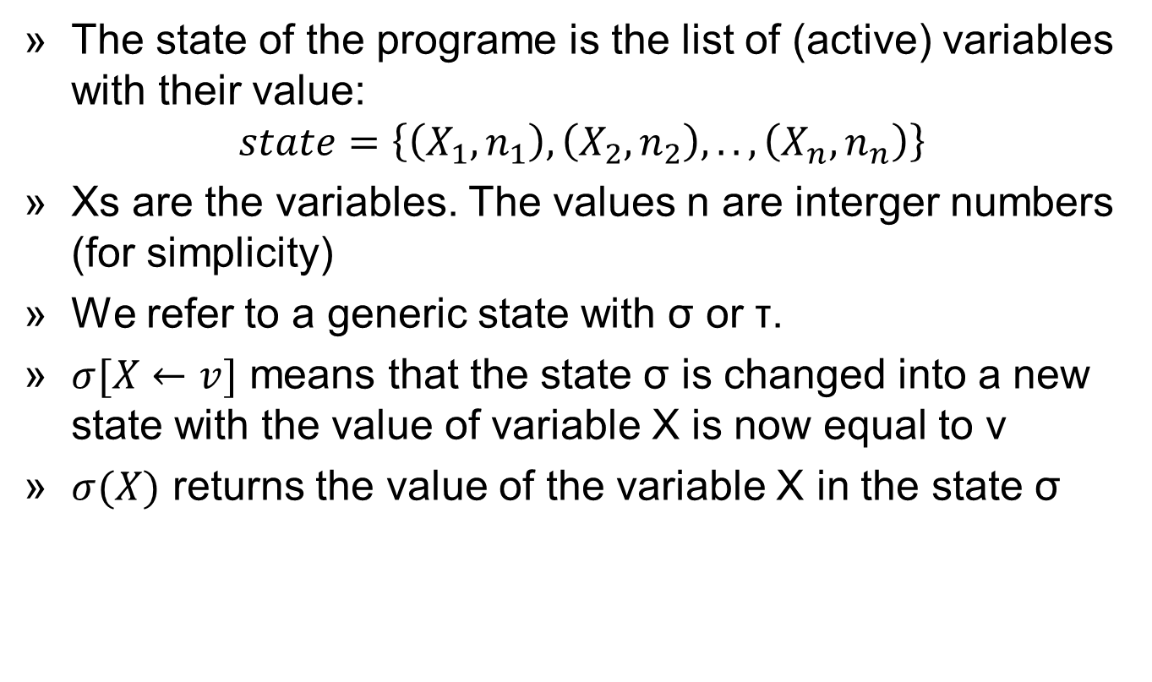
Description of the state
The state of the programe is the list of (active) variables with their value:
$$state=\left\{\left(X_{1},n_{1}\right),\left(X_{2},n_{2}\right),..,\left(X_{n},n_{n}\right)\right\}$$
Xs are the variables. The values n are interger numbers (for simplicity)
We refer to a generic state with σ or τ.
$σ[X←v]$ means that the state σ is changed into a new state with the value of variable X is now equal to v
$σ(X)$ returns the value of the variable X in the state σ

Slide 16
Transitions
The behaviour of a program is defined in terms of transitions
A transition defines how a command c changes the state from to σ to τ
<c,σ> → τ
Every instructions is described with the set of transitions that generates. Example
<skip,σ> → σ
<c,σ>→<c’ ,σ’>
<if tt then c1 else c2,σ>→<c1,σ>

Slide 17

Conditional Transitions
Some transitions are conditionals to other. The rule is written in the following way:
The meaning is: If the command, c1, starting in state σ1, can perform a computational step that transforms itself into command c1’ in state σ1’, and if c2, starting in σ2, can perform a computational step and transform itself into the command c2’ in state σ2’, then the command, c, starting in the state σ can perform a computational step and transform itself into the command c in state σ . In general, c1 and c2 will be subcommands of c

Slide 18
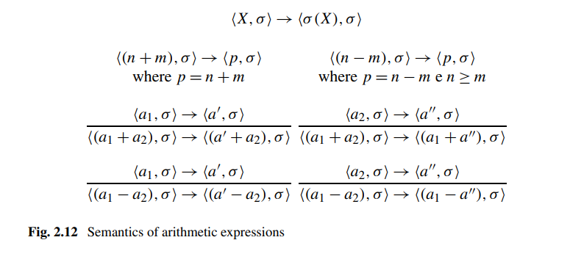
Semantics Rules /1
Arithmetic expressions
Top 3: Rules for variables and operation with numbers (terminal rules)
Rules for operations with expressions. In order to solve a1+a2 first I have to evaluate a’ and then a2

Slide 19
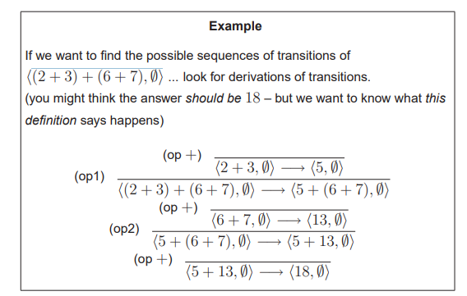
Example

Slide 20
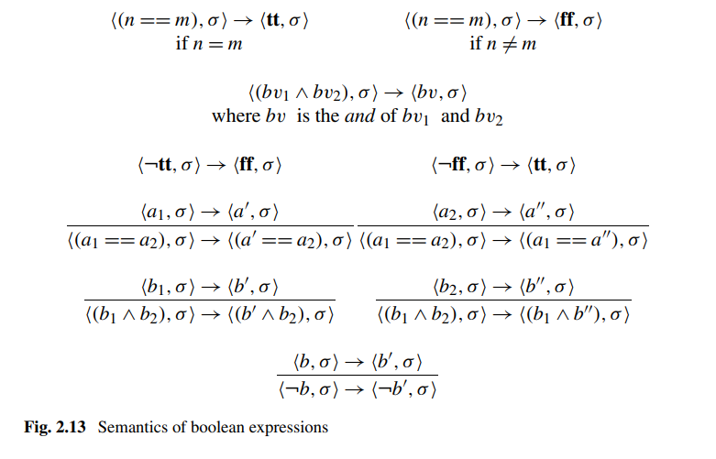
Semantics of Boolean Expressions

Slide 21
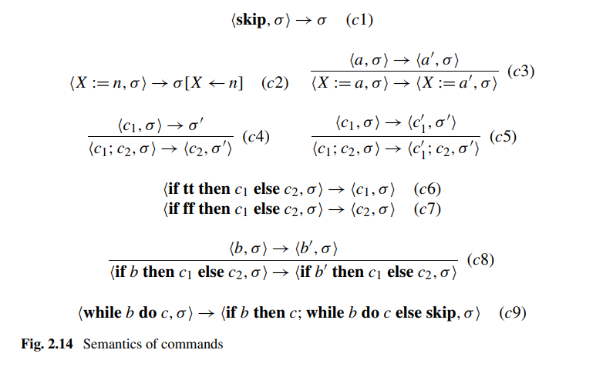
Semantics of Commands
$$<while b do c,σ>→<if b then \left(c;while b do c\right) else skip,σ>$$

Slide 22

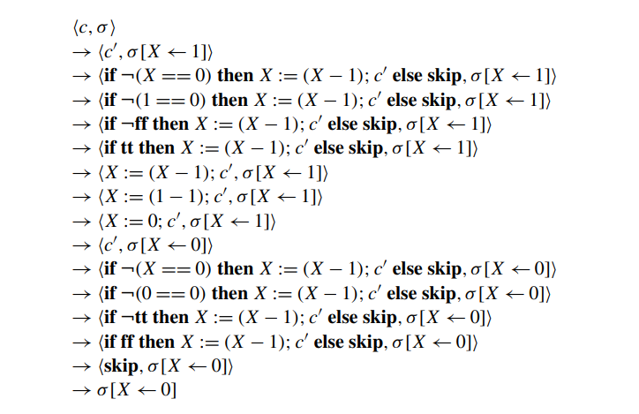
Sample Computation
= c’

Slide 23
Names and Denotable Objects
When we declare a new variable in a program:
int fie;
or we define a new function:
int foo( ){
fie = 1;
}
we introduce new names to represent objects.
The name is a character sequence used to represent, or denote, another object.
In most languages, names are formed of identifiers, that is by alphanumeric tokens, moreover other symbols can also be names.
For example, + and - are names which denote, in general, primitive operations.

Slide 24
Names and Denotable Objects
A name and the object it denotes are not the same thing.
A name is just a character string, while its denotation can be a complex object such as a variable, a function, a type, and so on.
A single object can have more than one name (aliasing), while a single name can denote different objects at different times.
When, therefore, we use, as we may, the phrase “the variable fie” or the phrase “the function foo”, it should be remembered that the phrases are abbreviations for “the variable with the name fie” and “the function with the name foo”.
More generally, in programming practice, when a name is used, it is almost always meant to refer to the object that it denotes.

Slide 25
Names and Denotable Objects
The use of names implements a first, elementary, data abstraction mechanism.
For example, when, in an imperative language, we define a name using a variable, we are introducing a symbolic identifier for a memory location; we are abstracting from the low-level details of memory addresses.
At the programming level, the use of the name avoids the need to bother with whatever this location is.
The correspondence between name and memory location must be guaranteed by the implementation.
We will use the term environment to refer to the part of the implementation responsible for the associations between names and the objects that they denote.
A procedure is a name associated with a set of commands, together with certain visibility rules which make its interface (composed of the procedure’s name and possibly some input and other parameters) available to the programmer.

Slide 26
Denotable Objects
The objects to which a name can be given are called denotable objects.
Although there are differences between programming languages, the following is a non-exhaustive list of possible denotable objects:
Objects whose names are defined by the user:
variables,
formal parameters,
procedures (in the broad sense),
user-defined types,
labels, modules,
user-defined constants,
exceptions.
Objects whose names are defined by the programming language:
primitive types,
primitive operations,
predefined constants.

Slide 27
Binding Names to Objects
The association (or binding) between a name and an object it denotes can therefore be created at various times.
We can identify the following phases for the creation of bindings of names to objects during the lifecycle of a program:
Design of language In this phase, bindings between primitive constants, types and operations of the language are defined (for example, + indicates addition, and int denotes the type of integers, etc.).
Program writing Given that the programmer chooses names when they write a program, we can consider this phase as one with the partial definition of some bindings, later to be completed.
The binding of an identifier to a variable, for example, is defined in the program but is effectively created only when the space for the variable is allocated in memory.

Slide 28
Binding Names to Objects
We can identify the following phases for the creation of bindings of names to objects during the lifecycle of a program:
Compile time The compiler, translating the constructs of the high-level language into machine code, allocates memory space for some of the data structures that can be statically processed.
For example, this is the case for the global variables of a program.
The connection between a variable’s identifier and the corresponding memory location is formed at this time.
Runtime All the associations that have not previously been created must be formed at runtime.
This is the case, for example, for bindings of variable identifiers to memory locations for the local variables in a recursive procedure, or for pointer variables whose memory is allocated dynamically.

Slide 29
Environment
DEF - The set of associations between names and denotable objects which exist at runtime at a specific point in the program and at a specific time during execution, is called the (referencing) environment.
The environment is therefore that component of the abstract machine which, for every name introduced by the programmer and at every point in the program, allows the determination of what the correct association is.
A declaration is a construct that allows the introduction of an association in the environment. High-level languages often have explicit declarations, such as:
int x;
int f (){
return 0;
}
type T = int;

Slide 30
Environment
Some languages allow implicit declarations which introduce an association in the environment for a name when it is first used.
There are various degrees of freedom in associations between names and denotable objects.
First of all, a single name can denote different objects in different parts of the program.
Consider, for example, the code
{int fie;
fie = 2;
{char fie;
fie = a;
}
}
The outermost name fie denotes an integer variable, while the inner one is of type character.

Slide 31
Environment
It is also possible that a single object is denoted by more than one name in different environments.
For example, if we pass a variable by reference to a procedure, the variable is accessible using its name in the calling program and by means of the name of the formal parameter in the body of the procedure.
Alternatively, we can use pointers to create data structures in which the same object is then accessible using different names.
While different names for the same object are used in different environments, no particular problems arise.
The situation is more complicated when a single object is visible using different names in the same environment.
This is called aliasing and the different names for the same object called aliases.
If the name of a variable passed by reference to a procedure is also visible inside the same procedure, we have a situation of aliasing.

Slide 32
Environment
Other aliasing situations can easily occur using pointers.
If X and Y are variables of pointer type, the assignment X = Y allows us to access the same location using both X and Y.
Let us consider, for example, the following fragment of C program where we assume that write(Z) is a procedure which allows us to print the value of the integer variable Z:
int *X, *Y; // X,Y pointers to integers
X = (int *) malloc (sizeof (int)); // allocate heap memory
*X = 5; // * dereference
Y=X; // Y points to the same object as X
*Y=10;
write(*X);
The names X and Y denote two different variables, which, however, after the execution of the assignment command X = Y, access the same memory location (therefore, the next print command will output the value 10).

Slide 33
Environment
It is, finally, possible that a single name, in a single textual region of the program, can denote different objects according to the execution flow of the program.
This might be the case, for example, for a recursive procedure declaring a local name.

Slide 34
Blocks
Almost all important programming languages today permit the use of blocks, a structuring method for programs introduced by ALGOL60.
Block structuring is fundamental to the organisation of the environment.
A block is a textual region of the program, identified by a start sign and an end sign, which can contain declarations local to that region.
The start- and end-block constructs vary according to the programming language:
begin ... end for languages in the ALGOL family,
braces {...} for C and Java,
round brackets (...) for LISP and its dialects,
The exact definition of block in the specific programming language can differ slightly from the one given above.

Slide 35
Blocks
Particular types of blocks include:
Block associated with a procedure: This is a block associated with declarations local to a procedure.
It corresponds textually to the body of the procedure itself, extended with the declarations of formal parameters.
In-line block: This is a block which does not correspond to a declaration of procedure and which can appear (in general) in any position where a command can appear.

Slide 36
Visibility
There are mechanisms that allow the declarations local to a block to be visible in blocks nested inside it.
We say that a declaration local to a block is visible in another block when the association created by such a declaration is present in the second block.
Those mechanisms of the language which regulate how and when the declaration is visible are called visibility rules.
The standard visibility rule for languages with blocks is:
A declaration local to a block is visible in that block and in all blocks listed within it, unless there is a new declaration of the same name in that same block.
The block which contains the redefinition of the new declaration hides the previous one.

Slide 37
Visibility
In the case in which there is a redefinition, the visibility rule establishes that only the last name declared will be visible in the internal block,
The association for the name declared in the external block will be deactivated for the whole of the interior block (containing the new declaration) and will be reactivated on exit from the inner block.
There is no visibility from the outside inwards.
Every association introduced in the environment local to a block is not active (or rather the name that it defines is not visible) in the exterior block which contains the interior one.
Similarly, if we have two blocks at the same nesting level, or if neither block contains the other, a name introduced locally in one block is not visible in the other.

Slide 38
Environment Components
In general we can identify three components of an environment for a block:
Local environment: This is composed of the set of associations for names declared locally to the block.
In the case in which the block is for a procedure, the local environment also contains the associations for the formal parameters, given that they are viewed as locally declared variables.
Non-local environment: This is the environment formed from the associations for names which are visible from inside a block but which have not been declared locally.
Global environment: This is the environment formed from associations created when the program’s execution began.
It contains the associations for names which can be used in all blocks forming the program.

Slide 39
Environment Components
The environment local to a block can be determined by only considering the declarations present in the block.
To determine the non-local environment we look outside the block.
Names introduced in the local environment can be themselves present in the non-local environment.
In such cases, the innermost declaration hides the outermost one.

Slide 40
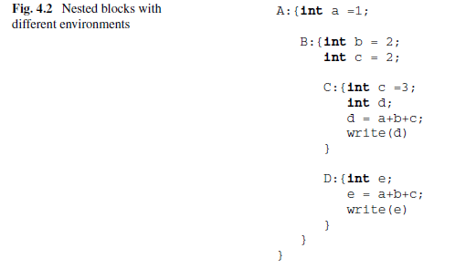
Visibility Example
Let us take a look at an example to illustrate visibility.
In this example, we assume that the blocks are labelled, with labels distinguishing blocks from one another:

Slide 41
Visibility Example
Block A represents the main program and declaring the variable a there introduces an association in the global environment.
Inside block B two variables are declared locally (b and c).
The environment for B is therefore formed of:
the local environment, containing the association for the two names b and c, and
the global environment containing the association for a.
Inside block C, 2 local variables (c and d) are declared.
The environment of C is therefore formed of:
the local environment, which contains the association for the two names c and d,
the non-local environment containing the same global environment as block A, and also the association for the name b which is inherited from the environment of block B.
however, the local declaration of c in block C hides the declaration of c present in block B.
The print command present in block C will therefore print the value 6.

Slide 42
Visibility Example
Inside block D, we have a local environment containing:
the association for the local name e,
the usual global environment, and
the non-local environment, which in addition to the association for a contains the association for the names b and c introduced in block B.
Given that variable c has not been internally re-declared in D, the variable c declared in block B remains visible and the value printed will be 5.
Note that the association for the name d does not appear in the environment non-local to D, given that this name is introduced in an exterior block at the same level of nesting which does not contain D.
The visibility rules allow only the inheritance of names declared in exterior blocks from interior ones and not vice versa.

Slide 43
Environments and Blocks
During the execution of the program, when a new block is entered, the following modifications are made to the environment:
Associations between locally declared names and the corresponding denotable objects are created.
Associations with names declared external to and redefined inside the block are deactivated.
When the block is exited, the environment is modified as follows:
The associations for names declared locally to the block and the objects they denote are destroyed .
The associations are reactivated between names that existed external to the block and which were redefined inside it.

Slide 44
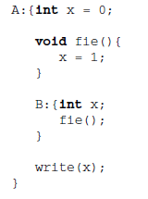
Scope
The environment can change on block entry and exit as a result of the operations for the creation, destruction, activation and the deactivation of associations.
These changes are reasonably clear for local environments, but are less clear where the non-local environment is concerned.
The visibility rules stated previously lend themselves to at least two different interpretations.
Look at the following piece of code:
Which value of x will be printed?

Slide 45
Scope
On the one hand, we could assume that the value 1 is printed, given that fie is defined in block A and, therefore, the x which appears in the body of the procedure could be that defined on the first line of A.
On the other hand, however, we can also argue that when we call fie, we are in block B, so the x that we are using n the assignment present in the body of the procedure is the one declared locally to block B.
This local variable is now no longer visible when we exit B, so write(x) refers to the variable x declared and initialised to 0 in block A and never again modified.
Therefore the procedure prints the value 0.
The result of the program fragment will depend on the scope rule being used.

Slide 46
Scope
The visibility rules stated earlier establish that a declaration local to a block is visible in that block and all the blocks nested within it but does not specify whether this concept of nesting must be considered in a static (based on the text of the program) or dynamic (based on the flow of execution) fashion.
When the visibility or scope rules depend only on the syntactic structure of the program, we will talk of a language with static or lexical scope.
When the rules are influenced by the control flow at runtime, we are dealing with a language with dynamic scope.

Slide 47
Static Scope
In a language with static (or lexical) scope, the environment in force at any point of the program and at any point during execution depends uniquely on the syntactic structure of the program itself.
Such an environment can then be determined completely by the compiler.

Slide 48
Static Scope
The static scope rule, or the rule of nearest nested scope, is defined by the following three rules:
The declarations local to a block define the local environment of that block.
The local declarations of a block include only those present in the block (usually at the start of the block itself) and not those possibly present in blocks nested inside the block in question.
If a name is used inside a block, the valid association for this name is the one present in the environment local to the block, if it exists.
If no association for the name exists in the environment local to the block, the associations existing in the blocks containing the one with which we started, from the nearest to the furthest, are checked.
If the outermost block is reached and it contains no association for the name, then this association must be looked up in the language’s predefined environment.
If no association exists here, there is an error.

Slide 49
Static Scope
The static scope rule, or the rule of nearest nested scope, is defined by the following three rules:
A block can be assigned a name, in which case the name is part of the local environment of the block which immediately includes the block to which the name has been assigned. This is the case also for blocks associated with procedures.
This definition corresponds to the informal visibility rules that we have already discussed, suitably completed by a static interpretation of the concept of nesting.

Slide 50
Static Scope
Static scope allows the determination of all the environments present in a program simply by reading its text.
This has two important consequences of a positive nature.
the programmer has a better understanding of the program,
this connection can also be made by the compiler which can therefore determine each and every use of a name, which makes it possible, at compile time, to perform a great number of correctness tests using the information contained in types, and to perform a considerable number of code optimisations.
For example, if the compiler knows (using declarations) that the variable x which occurs in a block is an integer variable, it will signal an error in the case in which a character is assigned to this variable.
If the compiler knows that a constant is associated with a particular value it can update the code by substituting every reference to that constant with the actual value before runtime.

Slide 51
Static Scope
Even with the static scope rules, the compiler cannot know in general which memory location will be assigned to the variable with name x nor what its value might be, given that this information depends on the execution of the program.
When using the static scope rule the compiler is in possession of some important information about the storage of variables (in particular it knows the offsets relative to a fixed position), that it uses to compile efficient accesses to variables.
This information is not available using dynamic scope, which, therefore, leads to less efficient execution.
For these reasons, most current languages (for example ALGOL, Pascal, C, C++, Ada, scheme and Java) use some form of static scope.

Slide 52
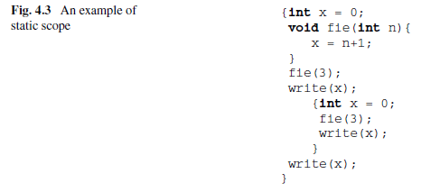
Static Scope Example
Consider the following code block:
The first and third occurrences of the write command print the value 4, whereas the second occurrence prints the value 0.
The formal parameter n is not visible outside the body of the procedure.

Slide 53
Dynamic Scope
Dynamic scope was introduced in some languages, such as, for example, APL, LISP (some versions), SNOBOL and PERL, mainly to simplify runtime environment management.
Static scope imposes a fairly complicated runtime regime because the various non-local environments are involved in a way that does not reflect the normal flow of activation and deactivation of blocks.
Under static scope, the sequence of blocks that must be considered to resolve references to non-local names is different from the sequence of blocks that is opened and exited during the program’s normal flow of control.
The opening and closing can be handled in a natural manner using the LIFO (Last In First Out) discipline, that is using a stack.
The sequence of blocks that need examining to implement static scope depends on the syntactic structure of the program and being able to handle it correctly at runtime depends upon the use of additional data structures.

Slide 54
Dynamic Scope
To simplify the management of the runtime environment some languages use the dynamic scope rule.
This rule determines the associations between names and denoted objects using the backward execution of the program.
In such languages, resolving non-local names requires only a stack dedicated to handling blocks at runtime.
The dynamic scope rule, also called the rule of the most recent association, can be defined as follows.
The valid association for a name X, at any point P of a program, is the most recent (in the temporal sense) association created for X which is still active when control flow arrives at P.
For the local and global environment, the two rules coincide.

Slide 55
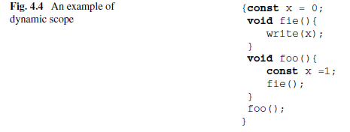
Dynamic Scope Example
Consider the following code fragment:
The outermost block is entered and associations are created between the constant x and the value 0, and between the names fie and foo and the associated procedures.
Next, a call to foo is executed and control is transferred to the block associated with that procedure.
Within this block, an association is created between the constant x and the value 1 and a call to fie is executed.

Slide 56
Dynamic Scope Example
The call to fie causes entry to a new block where the command write(x) is executed and given that x is not a name local to the block, the association for the name x must be looked up in outer blocks.
However, according to the rules of static scope, as presented in the last section, the first external block in which to look for the association for x is not the last block to be activated (it is the one for procedure foo in our example); such an external block depends on the structure of the program.
In this case, then, the correct association for the name x used by fie is the one located in the first block and consequently the value 0 is printed.
The block belonging to procedure foo, even though it contains a declaration for x and is still active, is not considered.

Slide 57
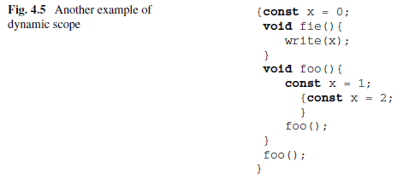
Dynamic Scope Example
Another example:
In a language with dynamic scope, the code prints the value 1 because when the command write(x) is executed, the last association created for x which is still active associates x with 1.
The association which associates x to 2, even if it is the most recent one to be created, is no longer active when procedure fie is executed and is therefore not considered.

Slide 58
Dynamic Scope
Dynamic scope allows the modification of the behaviour of a procedure or subprogram without using explicit parameters but instead by redefining some of the non-local variables used.
To explain this point, assume that we have a procedure visualise(text) which can visualise text in various colours, according to the value of the non-local variable colour.
If we assume that in the majority of cases, the procedure visualises text in black, it is natural to assume that we do not wish to introduce another parameter to the procedure in order to determine the colour.
If the language uses dynamic scope, in the case in which the procedure has to visualise a text in red, it will be enough to introduce the declaration for the variable colour before the call of the procedure.

Slide 59
Dynamic Scope
We can write:
...
{var colour = red;
visualise(head);
}
Then the call to procedure visualise now will use the colour red, because of the effect of dynamic scope.
This flexibility of dynamic scope, is, on the one hand, advantageous, yet, on the other, it often makes programs more difficult to read, given that the same procedure call, in conditions differing by only one non-local variable can produce different results.
If the variable (colour in our example) is modified in an area of program that is distant from the procedure call, understanding what has happened will probably turn out to be difficult.
For this reason, as well as for low runtime efficiency, dynamic scope remains little used in modern general-purpose languages, which instead use the static scope rule.

Slide 60
Passing a variable as Parameter: different Types
Input Only
They are sent by the caller to the callee
Ouput Only
They are returned by the callee to the caller
Input / Ouput
Bidirectional communication. Sent and received.
Linguistic Classification

Slide 61
Call by value
Input parameter
The actual parameter can be an expression.
When called, the actual parameter is evaluated and associated with the formal parameter.
On termination of the procedure, the formal parameter is destroyed,
During the execution of the body, there is no link between the formal and the actual parameter.
There is no way of make use of a value parameter to transfer information from the callee to the caller.

Slide 62
Call by value /2
Expensive method if the parameter is a large data structure
Only native way in C and Java…
.. But you can pass by value a pointer…
Clear semantics
Decoupling

Slide 63
Call by reference
Parameter must be a variable
Aliasing situation – the name of the parameters is an alias for the actual parameter
Bidirectional communication
An indirect reference is stored in the procedure local environment
Low-cost calling mode

Slide 64
Call by constant
Read-only parameter that can be pass by value or reference
Semantically it is like a call by value (unidirectional communication from the caller to the callee)
When implemented as a pass by reference, the method is low-cost (with the benefit of a passing by value)

